Slide 1
HTML5 Skeleton Page Structure
<!DOCTYPE html>
<html lang=“en”>
<head>
<meta charset="utf-8">
<title>Title Here</title>
</head>
<body>
Page content here
</body>
</html>

Slide 2

Mozilla Development Network
Add MDN to any “how to” search and it will bring up the Mozilla Development Network’s answer

Slide 3
HTML Tags
Proper HTML 5 standard compliance:
All tags and attributes lowercase
All attribute values quoted
All tags properly nested
All tags properly opened and closed
img tag is only empty tags: <img src=" "> or <img src=" " />
DO NOT USE <br> or <br />

Slide 4
HTML Tag Attributes
There are two very important HTML attributes that every tag supports. Both of these attributes are used as hooks to select elements for styling and scripting.
ID Attribute
Class Attribute
In HTML 5 the values for these attributes can contain almost any character. I would suggest you start the value with a letter [A-Za-z] and follow it by any number of letters, digits [0-9], hyphens (-), or underscores (_).
This will make your life a lot easier when it comes to using them for CSS or JavaScript hooks.
https://mathiasbynens.be/notes/html5-id-class

Slide 5
HTML tag ID Attribute
<div id=“use_me-once"></div>
The “id” attribute on an HTML tag is available for use on any HTML tag. It is a general attribute that works the same for all tags.
The “id” attribute is used to identify an element on the page
It is used as a hook to select an element for styling or scripting
A single value for an “id” attribute can only be used once per page
A individual HTML element can only have one value for an “id” attribute

Slide 6
HTML Tag Class Attribute
<div class=“sharedstyle"></div>
The “class” attribute on an HTML tag is available for use on any HTML tag. It is a general attribute that works the same for all tags.
The “class” attribute is used to classify an element on the page
It is used as a hook to select an element for styling or scripting
A single value for a “class” element can be used many time on a page. This is a way to group elements for styling or scripting.
A individual HTML element can have multiple values for an “class” attribute. Multiple values would be space separated inside the quotes.
<div class="tipsbox greentext"></div>

Slide 7
HTML Tags Inline or Block
HTML Tags are either block elements or inline elements by default. The standard behavior can be changed with CSS.
Block Tags
Fill width of window unless floated or positioned
Can contain other blocks (except <p>) and inline elements
https://developer.mozilla.org/en-US/docs/HTML/Block-level_elements
Inline Tags
Flows along with text content
Contains no block level elements, only other inline or text data
https://developer.mozilla.org/en-US/docs/HTML/Inline_elements
http://www.impressivewebs.com/difference-block-inline-css/

Slide 8
HTML Block Elements
If no width is set, will expand naturally to fill its parent container
Can have margins and/or padding
If no height is set, will expand naturally to fit its child elements (assuming they are not floated or positioned)
By default, will be placed below previous elements in the markup (assuming no floats or positioning on surrounding elements)
Ignores the vertical-align property
https://developer.mozilla.org/en-US/docs/HTML/Block-level_elements

Slide 9
HTML Inline Elements
Flows along with text content, thus
Will not clear previous content to drop to the next line like block elements
Is subject to white-space settings in CSS
Will ignore top and bottom margin settings, but will apply left and right margins, and any padding
Will ignore the width and height properties
If floated left or right, will automatically become a block-level element, subject to all block characteristics
Is subject to the vertical-align property
https://developer.mozilla.org/en-US/docs/HTML/Inline_elements

Slide 10
Text markup
ITMD-361

Slide 11
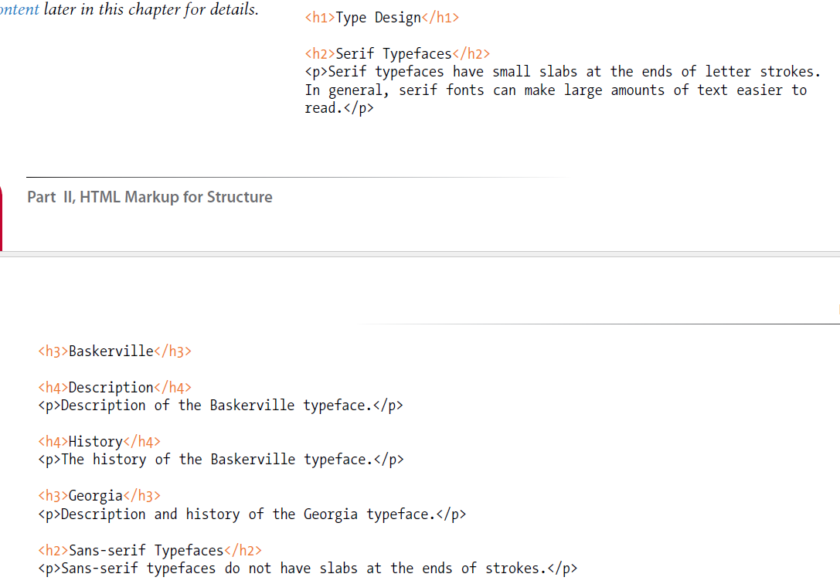

Slide 12
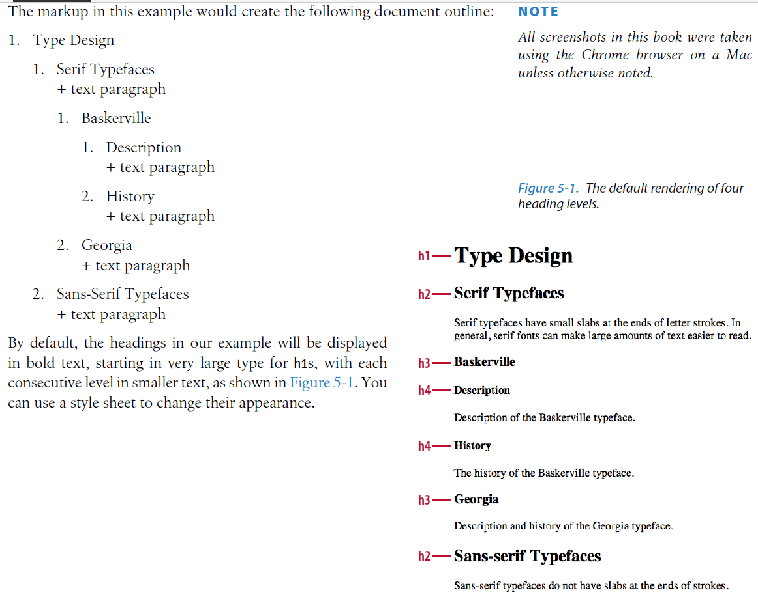

Slide 13
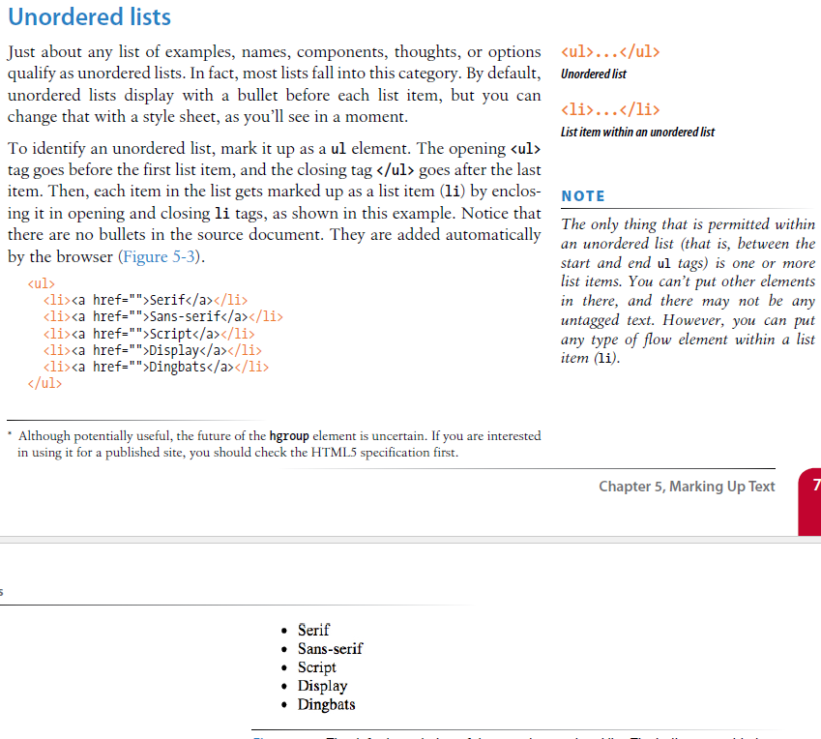

Slide 14
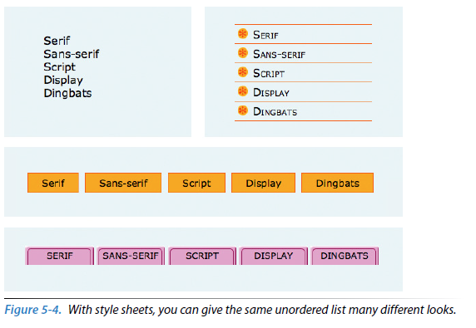

Slide 15
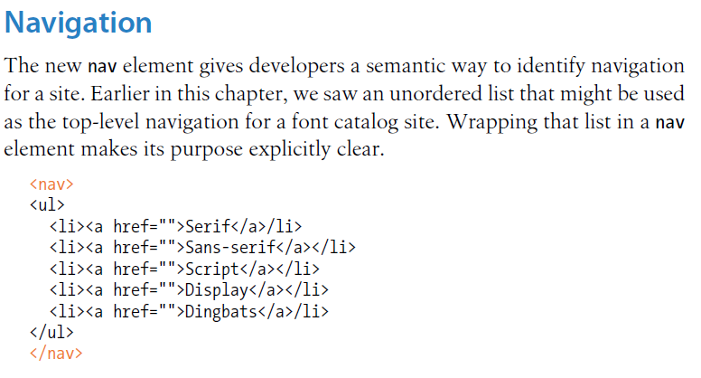

Slide 16
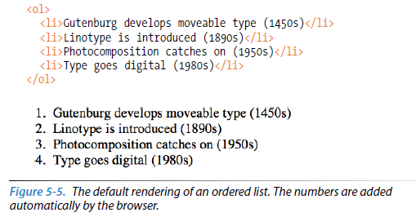
Ordered Lists

Slide 17
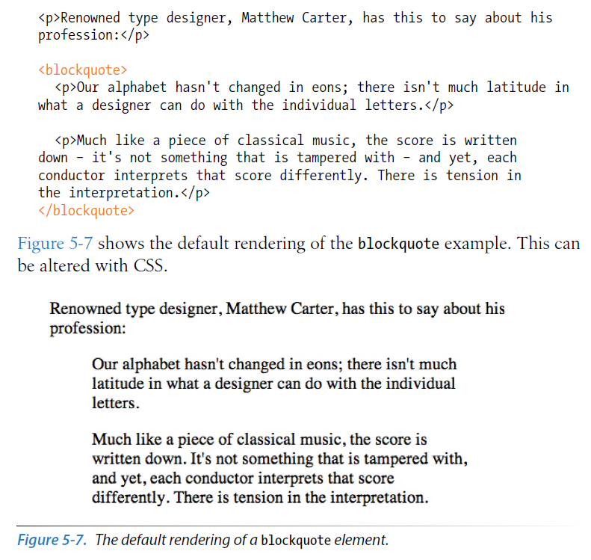

Slide 18
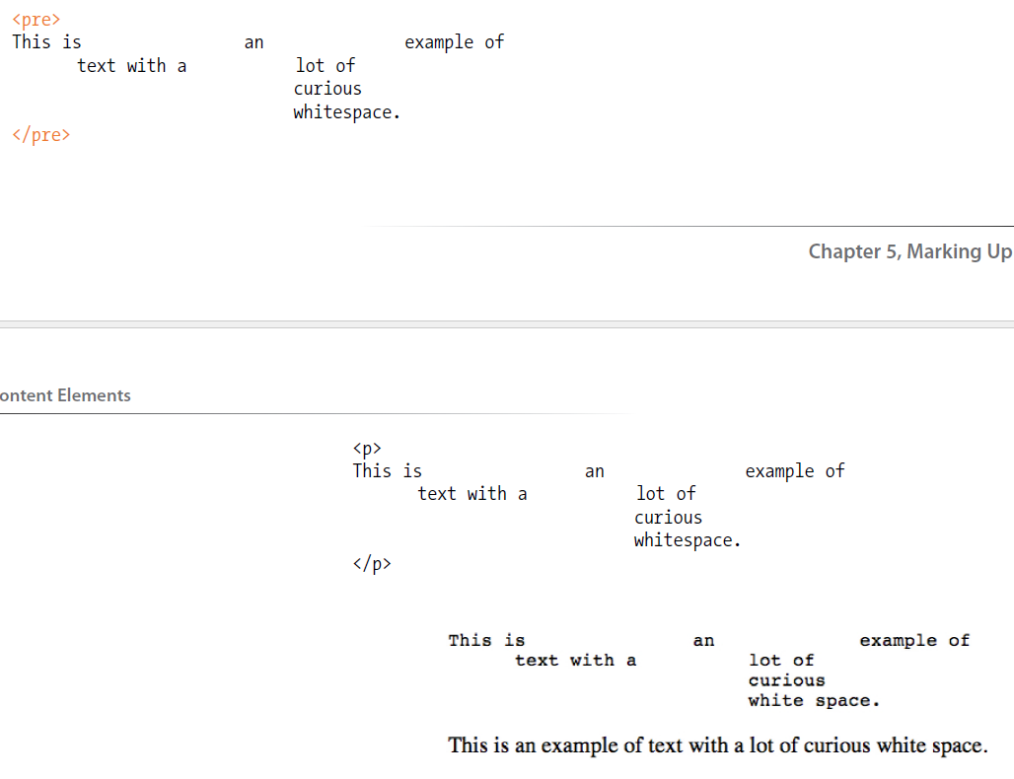

Slide 19
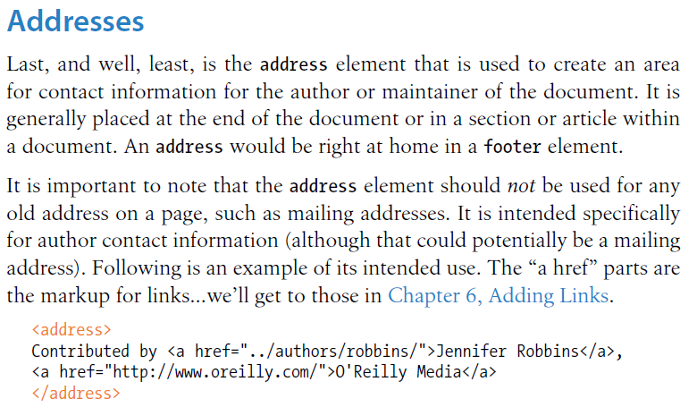

Slide 20
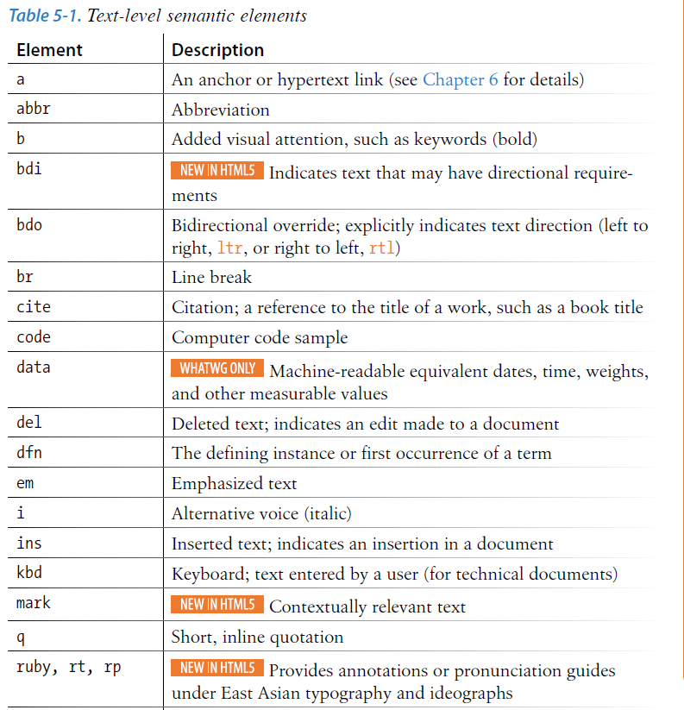

Slide 21
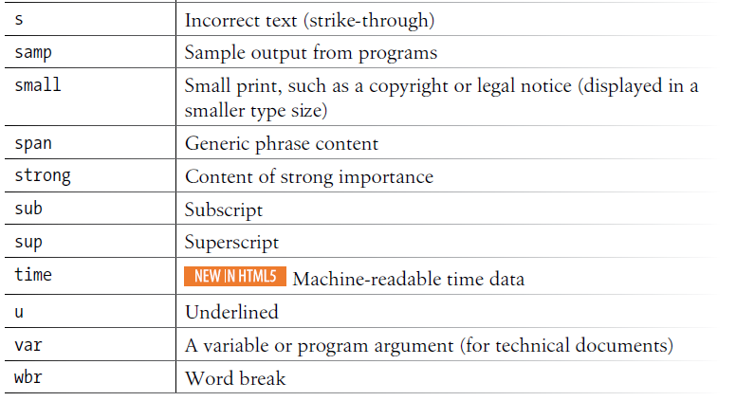

Slide 22
Special Characters
Some special characters need to be escaped or encoded in your HTML.
They are either escaped by their entity number or entity name.
All character references begin with a & and end with a ;
Must always escape the ampersand (&) since it signifies the start of a character reference
Example, Copyright symbol
&copy;
&#169;
http://dev.w3.org/html5/html-author/charref

Slide 23
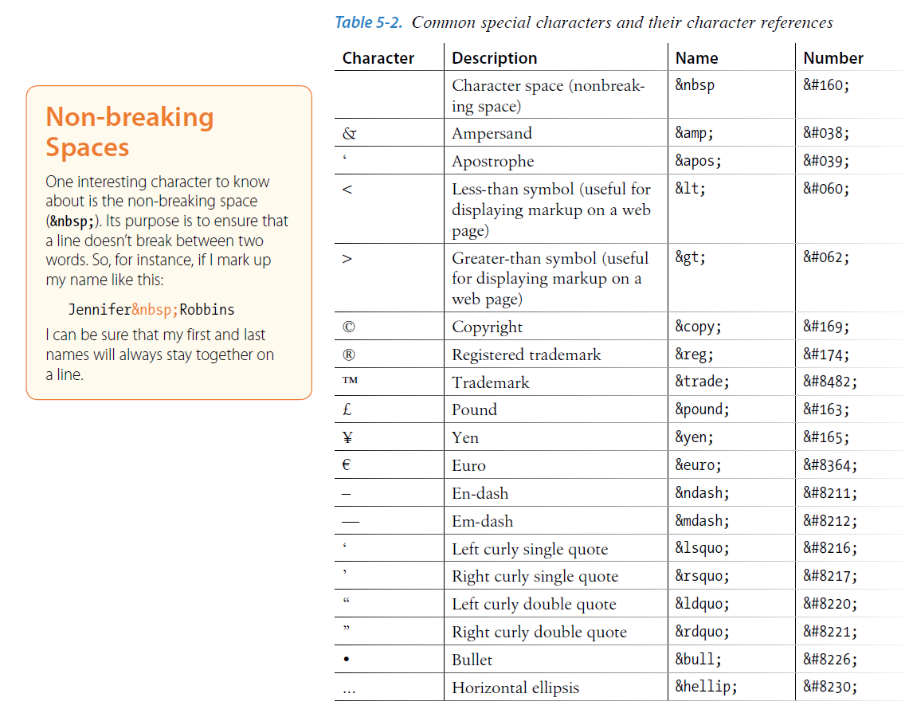

Slide 24
HTML Links
ITMD-361

Slide 25
HTML Links
Anchor element "a" is used to create links to internal or external pages.
Attribute "href" determines where the link goes when clicked.
Attribute "title" is the link title. Used for tooltip and assistive devices.
Can add attribute target="_blank" to have link open in new tab/window
href can be fully qualified domain and protocol or relative to current page on your server.

Slide 26
HTML Links
A fully qualified href would have protocol and domain
Example, href="http://www.iit.edu/"
A Little about pathing for relative links.
If the document exists in the same folder
href="page2.html"
Document exists in subfolder
href="folder/page2.html"
Document exists in folder one level above file
href="../page2.html"
Link to a document and folder structure relative to root
href="/folder1/folder2/page.html"
Pathing explained in the book starting on page 108 please read and make sure you understand. This is a common error.

Slide 27
HTML Img
ITMD-361

Slide 28
HTML Img
Images should be .png, .jpg or .jpeg, .gif format
We will discuss image formats in more detail in a later class.
.png and .gif support transparency
.jpg no transparency
.jpg should be 24bit RGB
.png can be 8bit index or 24bit RGB
.gif will be 8bit index
Typically .jpg is better for photos and .png is better for logos and graphics. Try to not use .gif unless necessary.

Slide 29
HTML IMG
Image Tag
Element is img, <img>
Empty element. No inner text node.
Needs to have a src attribute, <img src=" ">
Needs alt attribute to validate and for accessibility
Used to provide a textual description of the image
<img src=" " alt="red car">
Can provide a width and height attribute
Value is in pixels
<img src=" " width="200” height="100">
Providing the dimensions has some benefits
Image reserves the proper space as it loads
Allows you to scale an image although not ideal solution

Slide 30
HTML IFRAMe
An iframe element is a embedded window to other content.
This other content can exist on another server or the same server.
It is treated like a whole html page embedded in the part of the page the iframe defines
All the content in the iframe is completely separated from your page content. You can not style or interact with JavaScript any of the content of an iframe.
Typically used for embedding content, like youtube videos.
<iframe src="path to content" width="600" height="400"></iframe>

Slide 31
HTML Tables
ITMD-361

Slide 32
HTML Tables
HTML tables have historically been used for reasons other than their intended purpose.
Tables should be used to display tabular data
Tables should not be used to structure layout
In the past many web sites were built using tables to structure the layout.
This involved many nested tables
This is considered a bad practice these days and would be looked at poorly by most web design companies.
Page layout should be done all in CSS in modern web pages

Slide 33
HTML Tables
Main table defined and wrapped with <table> tag
Table rows are defined and wrapped with <tr> tag
Columns or cells are defined by <td> tags
Basic structure
Should be styled and sized with css – no style by default
<table>
<tr>
<td>R1 C1</td>
<td>R1 C2</td>
</tr>
<tr>
<td>R2 C1</td>
<td>R2 C2</td>
</tr>
</table>
R1 C1 | R1 C2
R2 C1 | R2 C2

